Slide 1
Big Mountain Resort
Revenue Generation Proposal

Slide 2
Revenue Needed to Offset Operational Cost
Big Mountain Resort installed a chair lift that added an operational cost of $1,540,000
This added operational cost eats into profits.
To offset this cost and become more profitable, revenue must be increased through:
Cost cutting measures without affecting the ticket price
Monetizing on features to support a higher ticket price.

Slide 3
Recommendation/Key Findings
Remove 1 run
Removing 1 run would not decrease support for the ticket price.
Add a run and chair lift to increase the vertical drop by 150ft.
Increases the ticket price by $8.61 and would generate a seasonal revenue of $15,065,471.
Fastquads, Runs, Vertical Drops, and SnowMaking are the four most important features in pricing

Slide 4
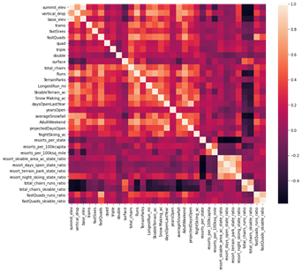
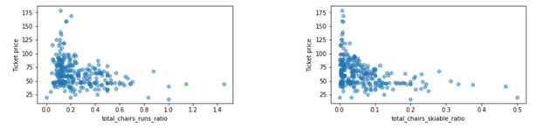
Exploratory Data Analysis
Based on heat map following features have a positive correlation with price
fastQuads
Runs
Snow Making_ac
Runs, vertical drop
resort_night_skiing_state_ratio
Total chairs
Upon investigation, increasing total chairs decreases ticket price
Charge more with limited seats

Slide 5
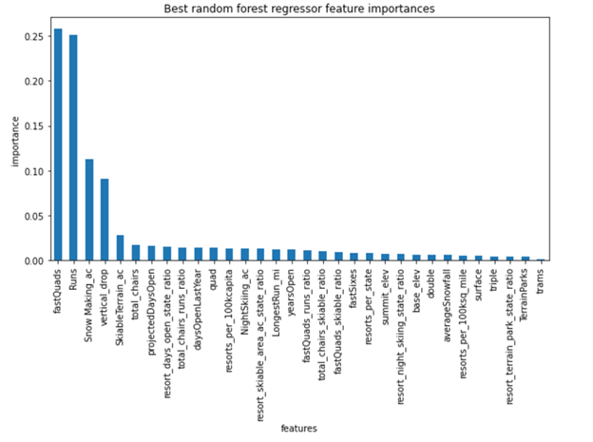
Random Forest Model
Random Forest Model lists top four features
fastQuads
Runs
SnowMaking
Vertical drop
Agrees with linear regression model and the EDA
Random Forest Model was chosen because it has a lower cross-validation mean absolute error and aa lower standard deviation for the mean absolute error.

Slide 6
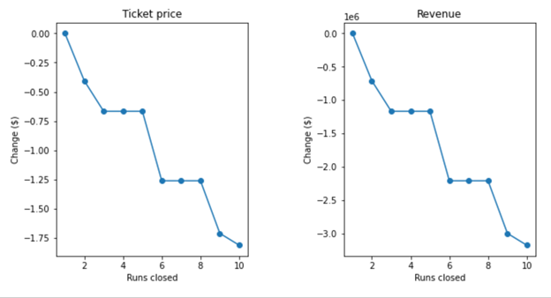
Removing Runs
Removing runs would cut costs BUT might affect support for ticket price
Removing 1 run would not affect the ticket price
Removing 1 run would still cut costs
Removing more than one would result in a decrease in ticket price

Slide 7
Scenarios
Assumptions made:
350,000 visitors buy 5 day passes for season
Scenario 2: Add 150 ft vertical drop with run and chair lift
Increases ticket price to $8.61. Annual revenue of $15,065,471.
Scenario 3: Scenario 2 with 2 acres of snowmaking
Increases ticket price to $9.90.
Scenario 4: Increase longest run by adding 0.2 miles and add a snow making machine to cover 4 acres
Does nothing to ticket price

Slide 8
Conclusion
Scenario 2 and Scenario 3 have a price difference of $1.29
Addition of snow making is insignificant and will generate higher capital cost and operation cost
Combining Scenario 1 and Scenario 2 would be best
Removing only 1 run cuts the cost
Scenario 2 generates a higher ticket price

